Slide 1

Using Google Maps with R
Tue 8th July, 10:45am – 4pm
Dr Nick Bearman
@nickbearmanuk
Department of Geography and Planning
Geographic Data Science Lab

Slide 2


Welcome
Using Google Maps with R
Who has used Google Maps before?
Who has used R before?
Who has used another GIS before?
(ArcGIS, MapInfo, QGIS, ….)
Who has used spatial data before?
(and not raised their hand so far!)

Slide 3
Outline of the day
11am – 11:30am – Talk
11:30am – 12:45pm – Practical
12:45pm – 1:30pm – Lunch
1:30pm – 2:30pm – Practical
2:30pm – 3pm – Talk
3pm – 4pm – Optional Mapping Clinic

Slide 4
Outline
What will you get from the course?
What is R & what can you do with it?
R as a GIS
Projections / Coordinate Systems
Notes on using R
Notes on crime data

Slide 5
What will you get from the course?
What are you expecting from the course?
Post-it notes

Slide 6
What will you get from the course?
Background on R and using R as a GIS
How to do mapping in R
With Google and without
Pros and cons of using R
Working with sensitive data
Presentations etc. will be available online

Slide 7
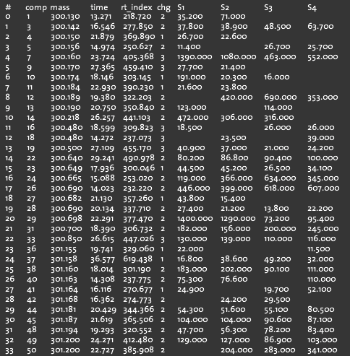
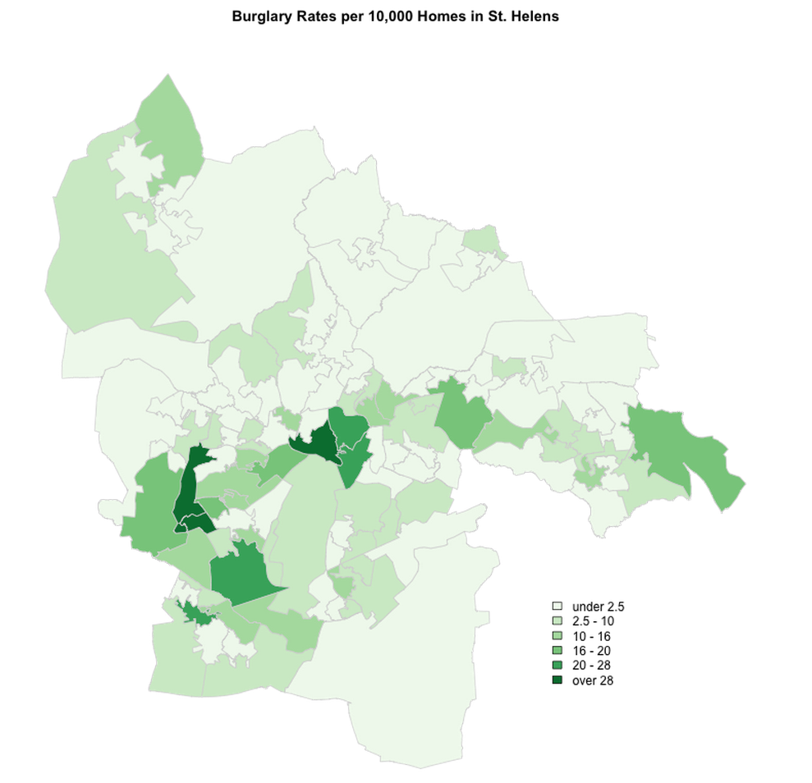
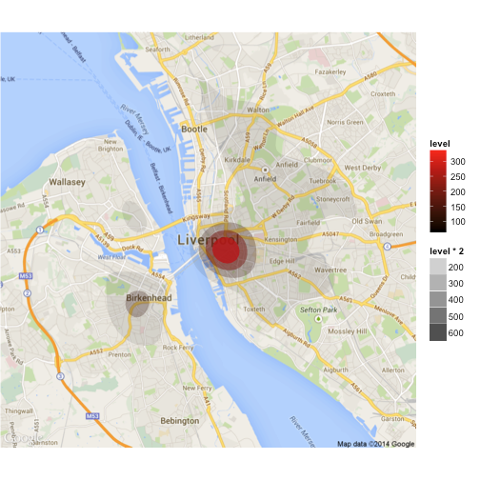
What is GIS?
Turning (spatial) data into information
Using this information to answer questions
How have housing conditions changed in the past ten years?
http://www.flickr.com/photos/dsleeter_2000/3097476532

Slide 8
GIS – Geographic Information Systems
Almost all human activities and decisions involve an important geographic component
the ‘where?’
Working with geographic information involves unique, complex and difficult choices
Why we need specialized software
organize and store
access and retrieve
manipulate and synthesize
apply to the solution of problems

Slide 9

What is R?
“a freely available language and environment for statistical computing and graphics”
freely available = ‘free as in beer’ and ‘free as in speech’
graphics = GIS
user contributed – GIS
packages / libraries

Slide 10
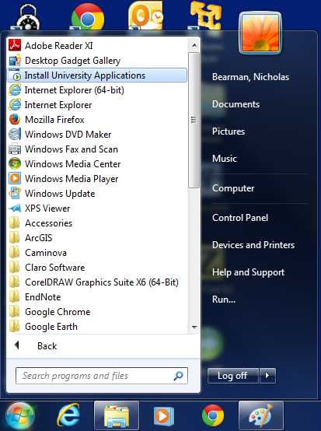
Installing R 3.0.1…
Logon

Slide 11
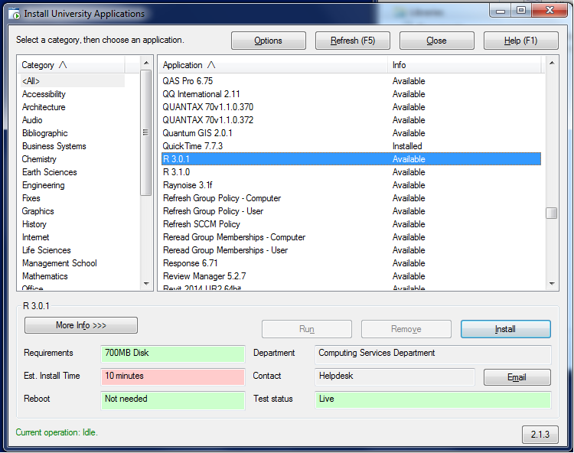
Installing R 3.0.1…

Slide 12
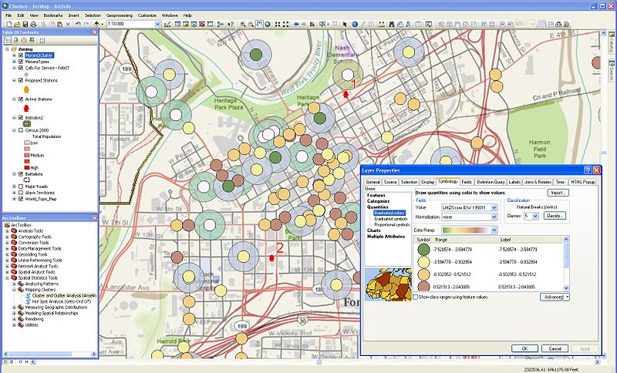
GIS – Geographic Information Systems
http://en.wikipedia.org/wiki/File:Arcgisclusters.jpg

Slide 13
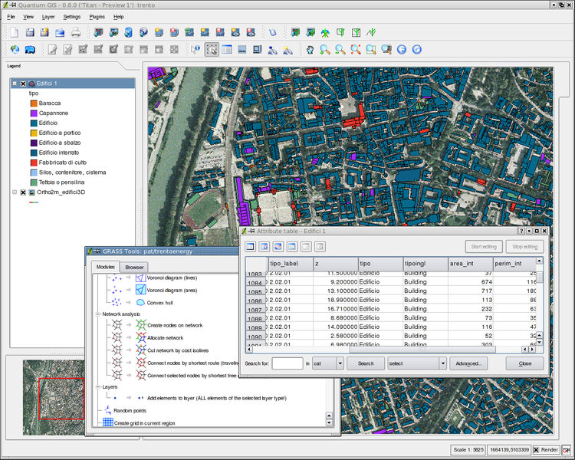
GIS – Geographic Information Systems
http://en.wikipedia.org/wiki/File:Qgis08_grass6_toolbox.png

Slide 14
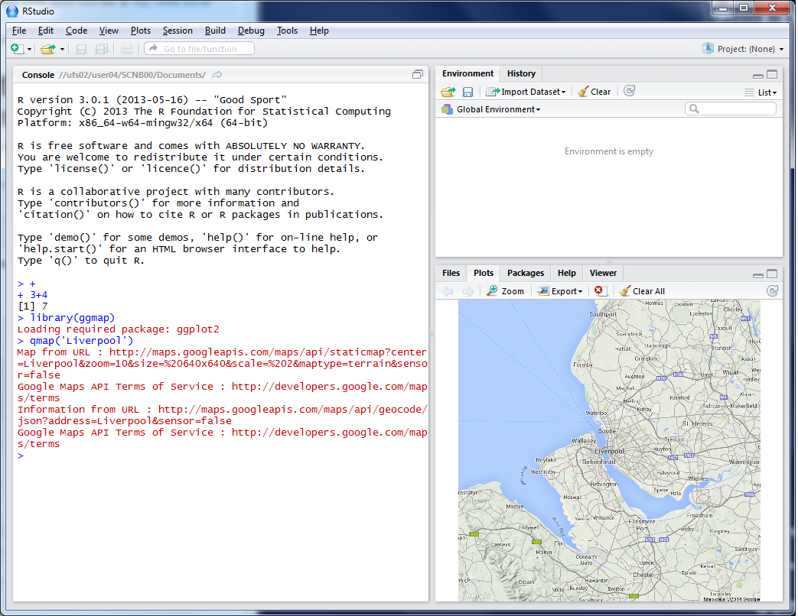
R as a GIS
Command line driven, rather than GUI
Disadvantages
Remembering commands
Steeper learning curve

Slide 15
R as a GIS
Advantages
Easy to record what you did and repeat specific pieces of work
Lots of reproducible examples on the web
Easily scriptable. 134,567 maps? easy!
2011 Census Open Atlas
http://www.alex-singleton.com/r/2014/02/05/2011-census-open-atlas-project-version-two/

Slide 16
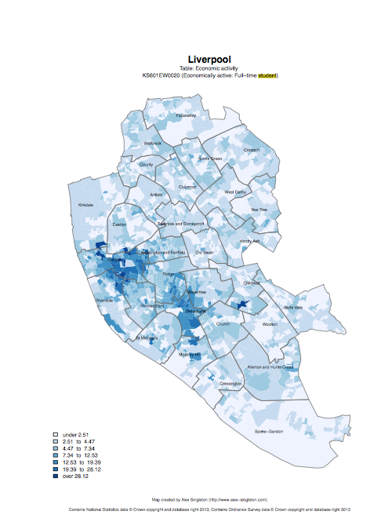

R in Action
Economically active – Full-time students

Slide 17
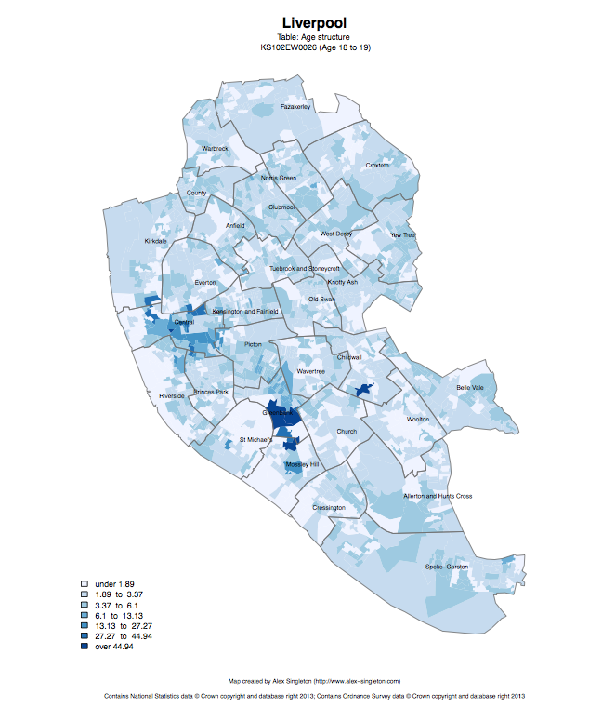
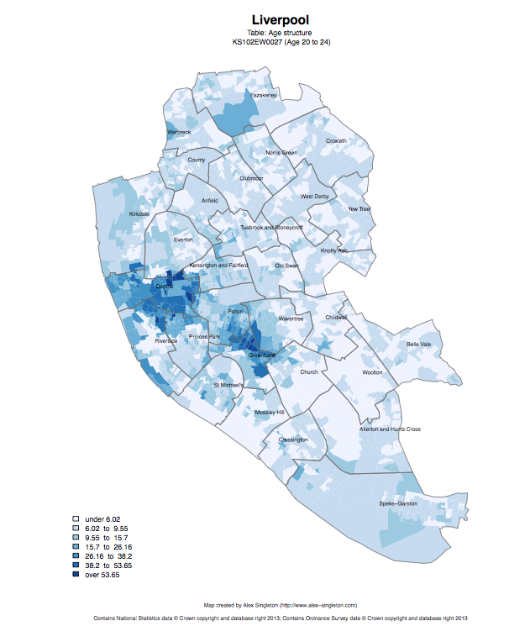
Age structure – 18 to 19
Age structure – 20 to 24

Slide 18
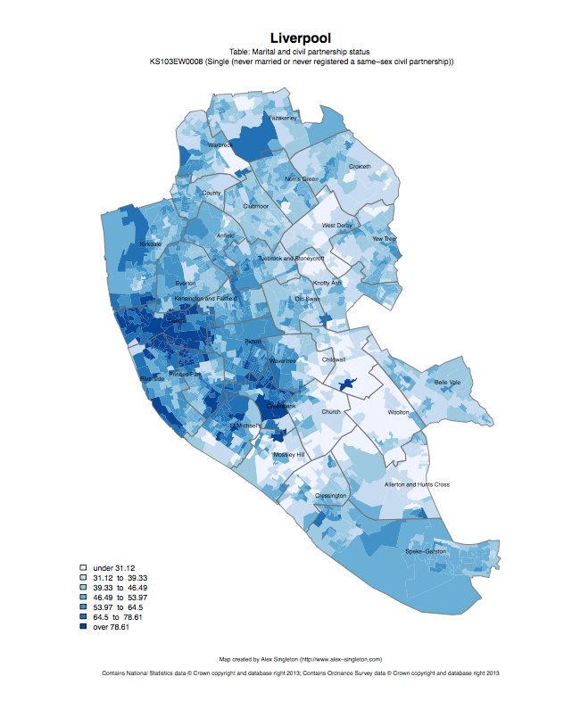
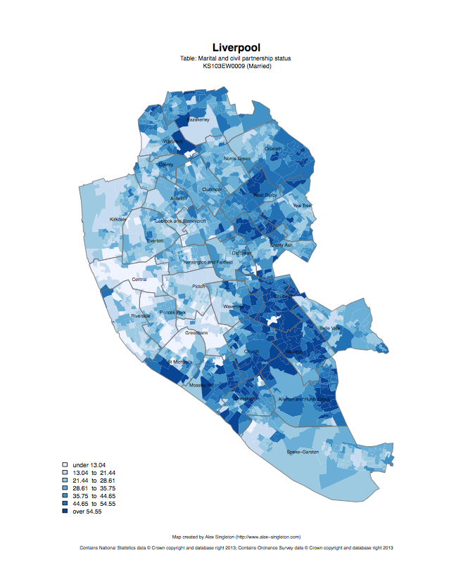
Single
Married

Slide 19
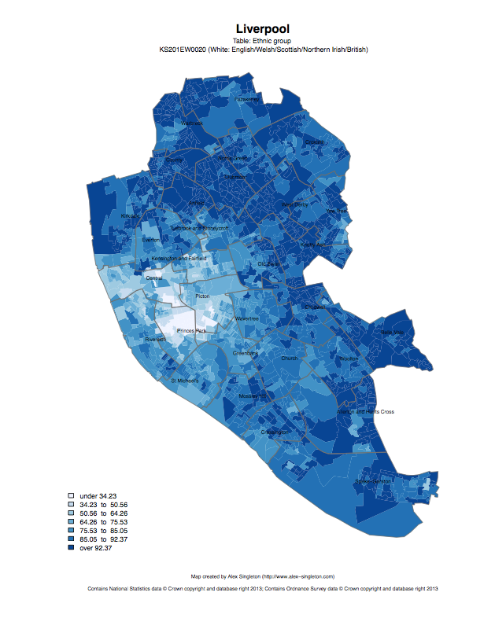
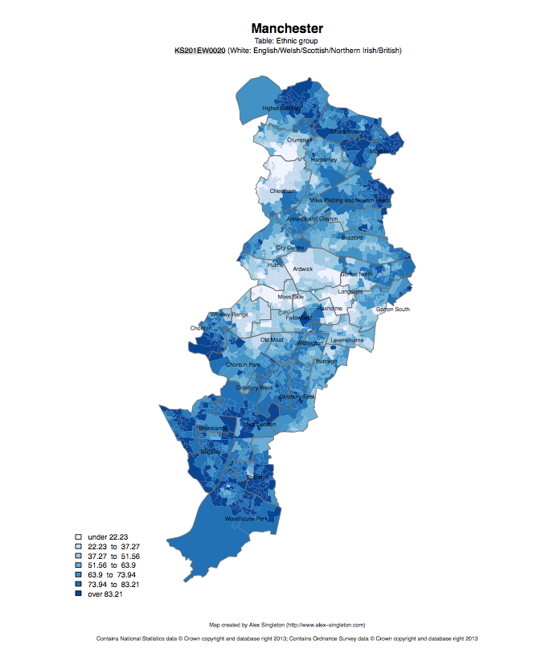
Ethnic group: white

Slide 20
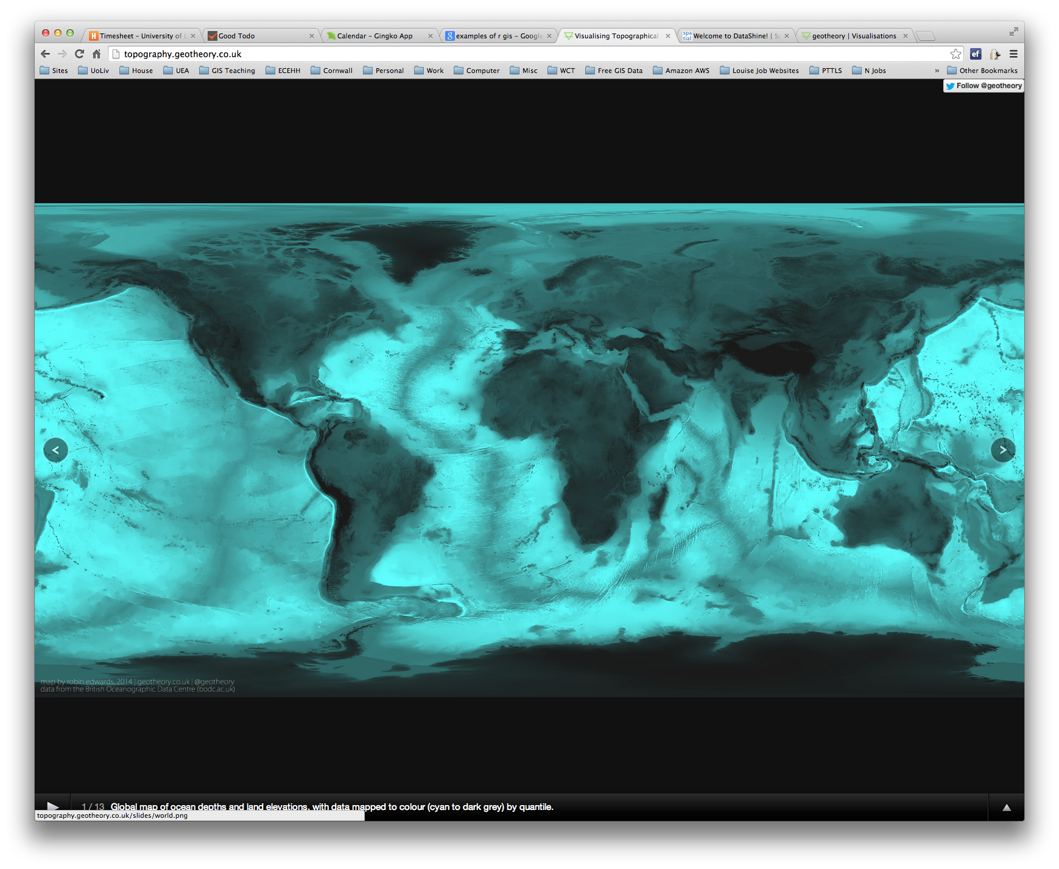
R as a GIS
Topography
http://topography.geotheory.co.uk/

Slide 21
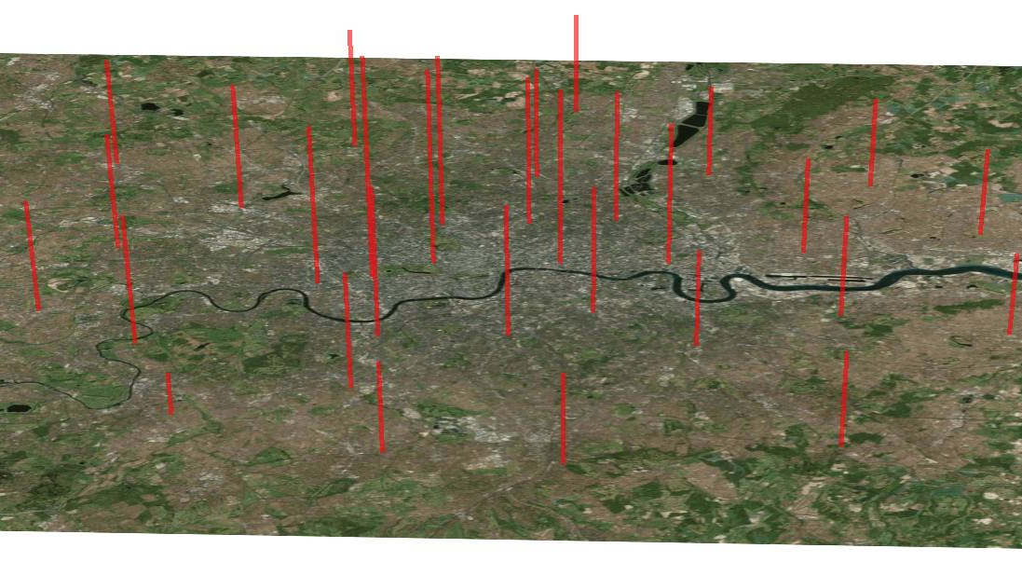
3D Mapping – London’s rental costs
http://spatial.ly/2013/05/3d-mapping-r/

Slide 22
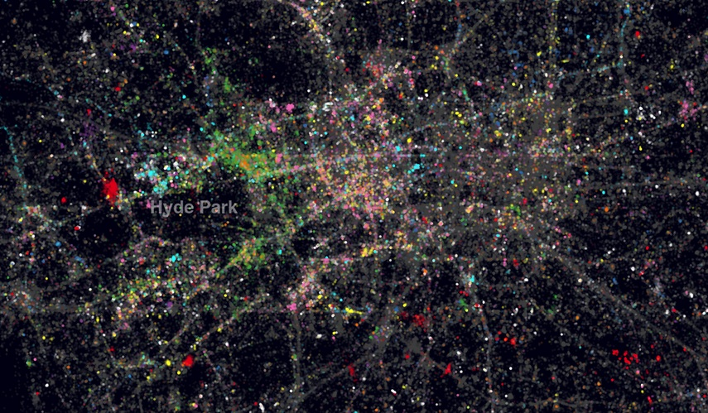
Twitter Languages in London
http://spatial.ly/2012/10/londons-twitter-languages/

Slide 23
R as a GIS
R is just another tool in the toolbox
I use it alongside ArcGIS, QGIS, etc.

Slide 24

Projections
Projection – going from a sphere to a flat surface

Slide 25
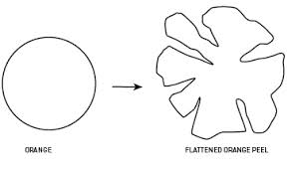
http://www.learner.org/courses/mathilluminated/units/8/textbook/05.php

Slide 26
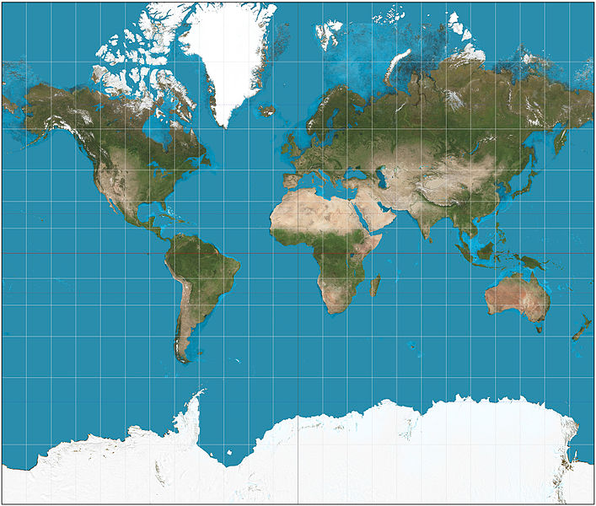
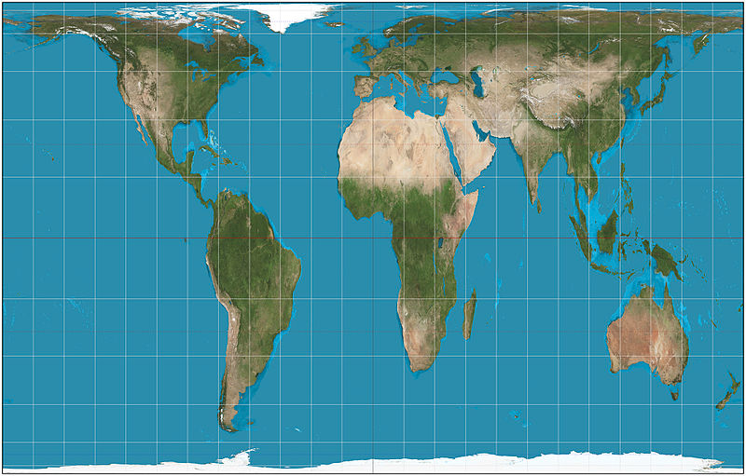
This file is licensed under the Creative Commons Attribution-Share Alike 3.0 Unported license. http://en.wikipedia.org/wiki/File:Mercator_projection_SW.jpg
Mercator projection
Peters projection
This file is licensed under the Creative Commons Attribution-Share Alike 3.0 Unported license. http://en.wikipedia.org/wiki/File:Gall%E2%80%93Peters_projection_SW.jpg

Slide 27
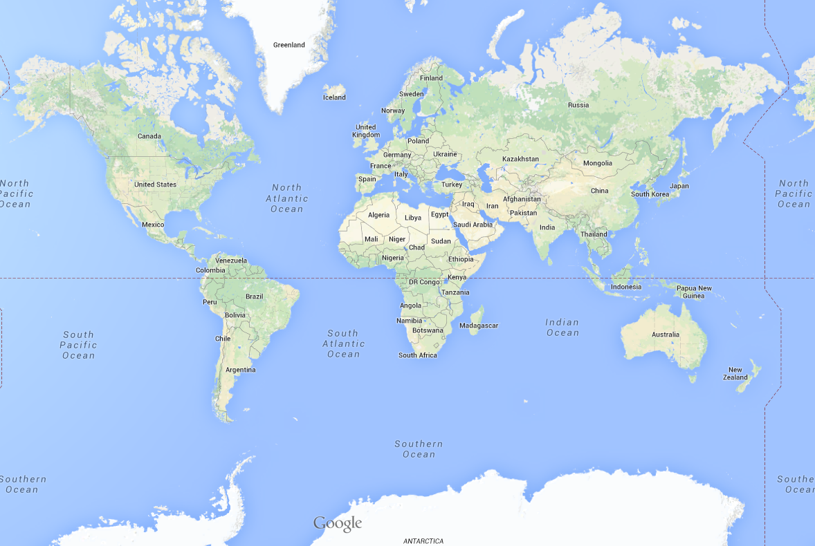
Africa: 30 million sq km
Greenland: 2 million sq km

Slide 28
Projections etc.
Africa: 30 million sq km
Greenland: 2 million sq km

Slide 29
Why are Projections important?
The map(s) may not be as they appear
Coordinate Systems

Slide 30
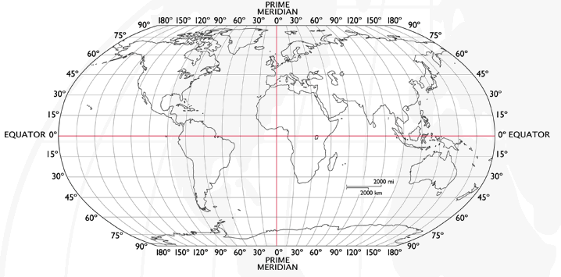
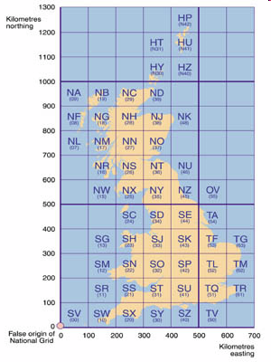
Coordinate Systems
Latitude and Longitude (WGS 1984) EPSG = 4326
52°N 37’ 30.32’’ (52.6250) 1°E 14’ 2.05’’ (1.2339)
British National Grid (Eastings & Northings)
Easting: 619301 Northing: 307416 EPSG = 27700
Why is it important?
Police crime data in WGS84 (lat/long)
Google Maps uses WGS84
LSOA use BNG (Eastings/Northings)
Need to convert between the two
Notes:
-Coordinate Systems are derived from projections and are used to give coordinates (numbers) to locations on the Earth’s surface
-Best if your data is all in the same coordinate system (otherwise the coordinates might be slightly different for the same location), but ArcMap can convert between them
-Most common:
-Lat/Long (also WGS 1984) used by most GPS
-BNG (British National Grid) very common in UK data – Ordnance Survey format.
-Most important – are all your data in the same coordinate system?
-ArcMap can convert, but often if your data appears in the wrong place, it is because there is something wrong with the coordinate system.
http://www.worldatlas.com/webimage/testmaps/latslongs.htm
http://www.ordnancesurvey.co.uk/oswebsite/gps/information/coordinatesystemsinfo/guidetonationalgrid/page13.html
http://www.ordnancesurvey.co.uk/oswebsite/gps/information/coordinatesystemsinfo/guidetonationalgrid/page8.html

Slide 31
Working Directory
R uses a ‘working directory’ to store your files in
You might have a different one for each project / piece of work
e.g. M:\Documents\GIS
setwd(“M:/Documents/GIS”)

Slide 32
Variables
R uses variables to store information – listed in your ‘workspace’ (top-right)
When you close R Studio, save workspace
motorways <- readShapeSpatial('meridian-2/ motorway_polyline', proj4string = CRS("+init=epsg:27700"))

Slide 33
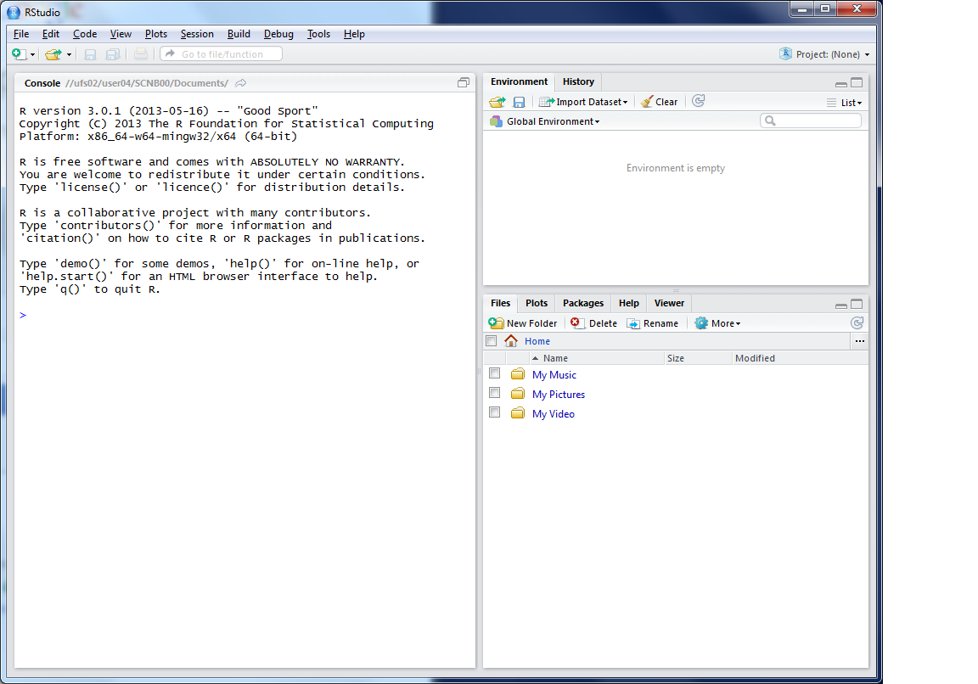
This lists the variables you have
This is the console where you can type in commands
Here will show either your files (the files tab) or your plots (the plots tab)

Slide 35
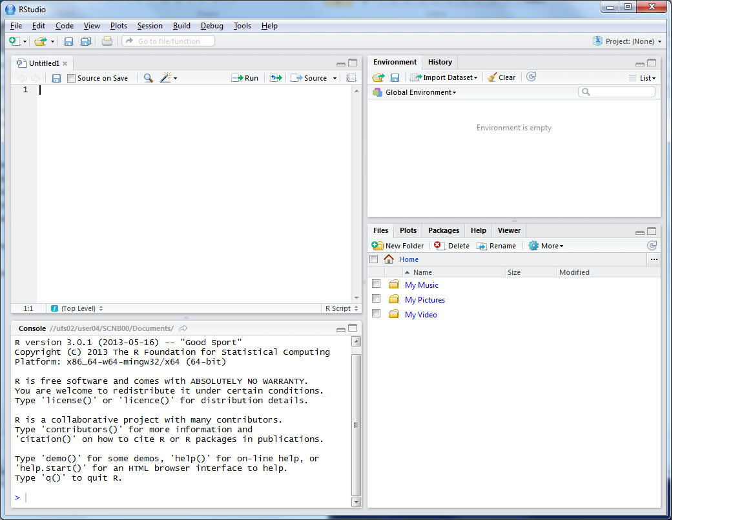
This is where you can write scripts
This lists the variables you have
Link to survey:
Here will show either your files (the files tab) or your plots (the plots tab)
This is the console where you can type in commands

Slide 36
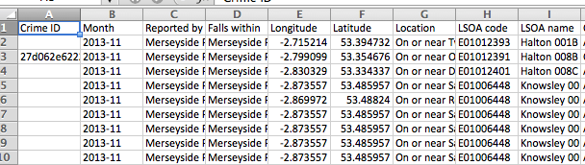
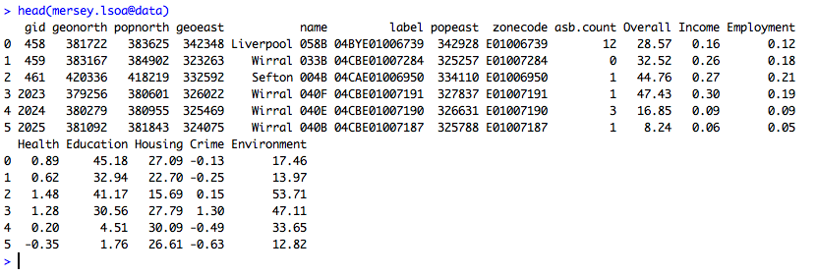
Crime Data

Slide 37
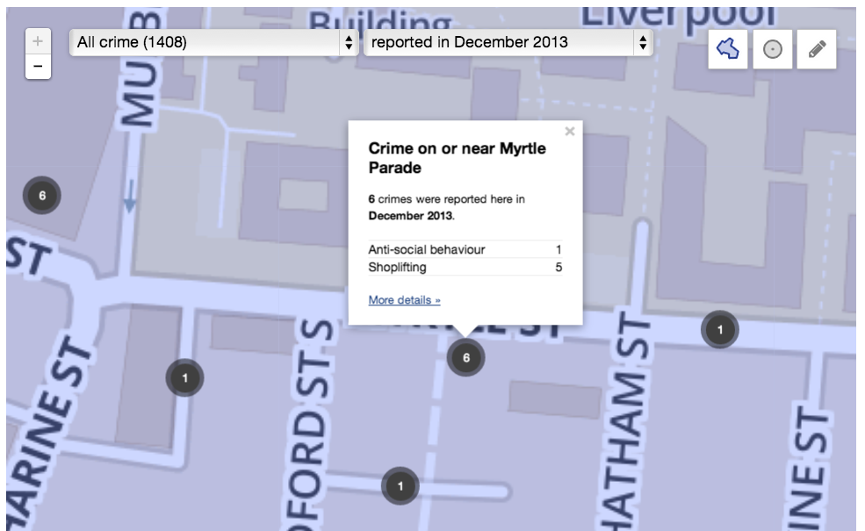
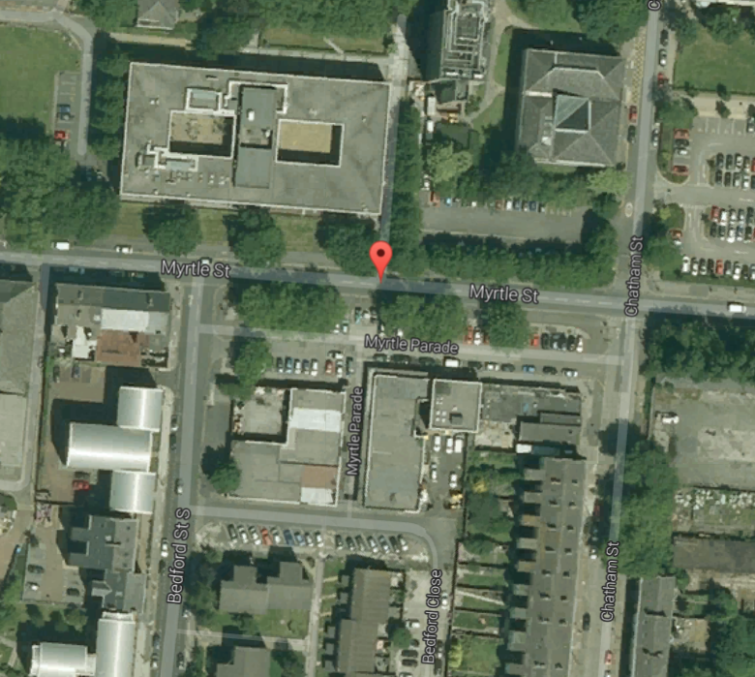
Maps are not necessarily as they appear
Think about the map – what does it mean?
Things are not always as they seem

Slide 38
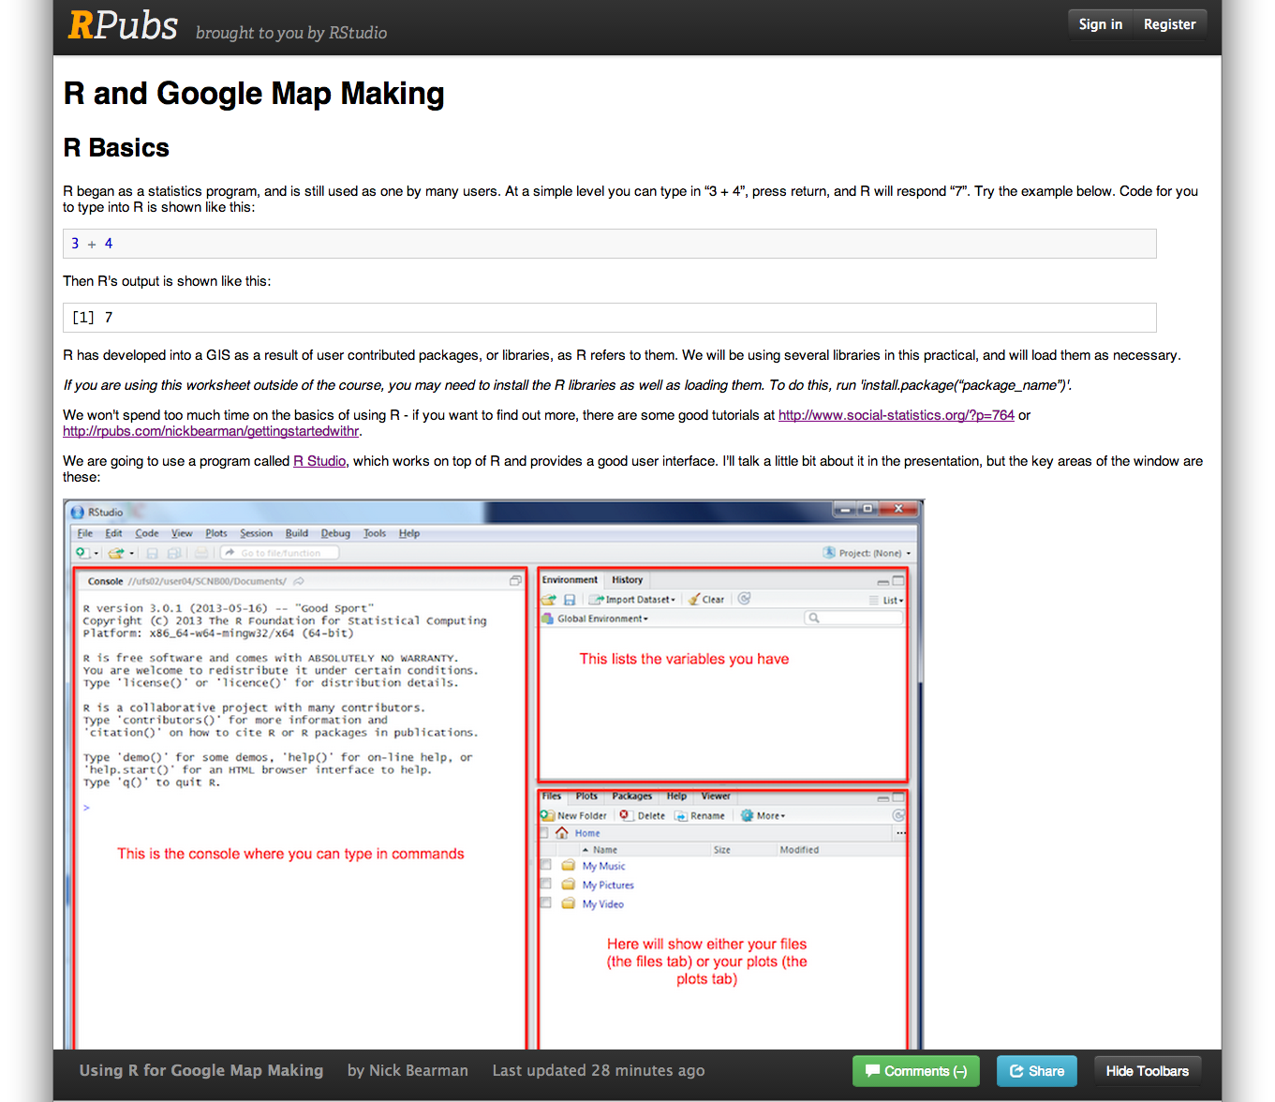
Practical

Slide 39
Survey Questions
Part of my research is GIS teaching
Very quick (7 ques) survey of your GIS experience
Follow up in 6 months / 1 year
Optional

Slide 40
Installing R Studio 0.98…

Slide 41
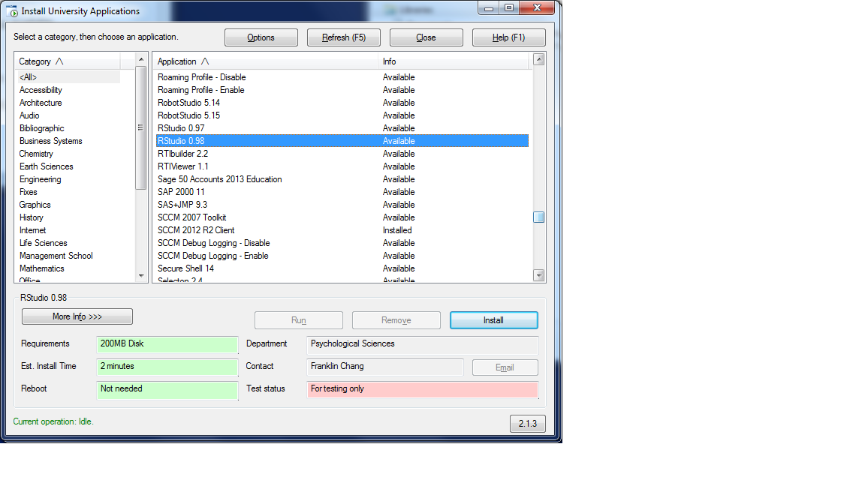
Installing R Studio 0.98…
bit.ly/1oBRqmY

Slide 42
Survey: bit.ly/1oBRqmY
Practical:
bit.ly/1mAH3kY

Slide 43
Go!

Slide 44
Recap
Recap of the practical
What is sensitive data?
Encryption
Cloud
Feedback
Where now?

Slide 45
The Practical
Using R & R Studio
Creating R scripts (& saving them!)
Importing data (crime, roads, LSOAs)
Plotting on top of Google Maps basemap
Routing & Density plots
Available online
Thursday on Geodemographics

Slide 46
Why is sensitive data important?
Data Protection Act
“Appropriate technical and organisational measures shall be taken against unauthorised or unlawful processing of personal data and against accidental loss or destruction of, or damage to, personal data.”
Information security (Principle 7)
Laptops on trains & buses….

Slide 47
What is sensitive data?
Personally identifiable data
DOB, Race, Location…
Often data provider will insist on certain measures
School census data
Encryption, only identified authorised users
Your experience?? (discuss)

Slide 48
Encryption
Recommended for desktop, required for laptop computers
TrueCrypt for sets of files
https://truecrypt.ch/ / GRC
Windows BitLocker / OSX File Vault 2
Research. Also backups!
Don’t forget organisational measures

Slide 49
Sensitive data in the Cloud
Data Protection Act
Personal data shall not be transferred to a country or territory outside the EEA unless that country or territory ensures an adequate level of protection for the rights and freedoms of data subjects in relation to the processing of personal data.
Sending personal data outside the European Economic Area (Principle 8)

Slide 50
Sensitive data in the Cloud
Google Cloud Computing
Finland, Belgium, Ireland
"however at this time selection of data center will make no guarantee that your data at rest is kept only in that region” (FAQ)
Amazon EC2 – Ireland (not UK)
Things will change in the future

Slide 51
Where now?
R resources on the web
www.rpubs.com/nickbearman
www.youtube.com/user/marinstatlectures/playlists
http://cran.r-project.org/doc/contrib/intro-spatial-rl.pdf
R problems
www.alex-singleton.com/R-Tutorial-Materials/
“Why doesn’t my code work? - Common things to check”

Slide 52
Feedback
Feedback is really important for me
Post-its
One thing you found fun
One thing you found challenging and useful
One thing you would improve
Or email / phone / in person

Slide 53
Thank you!

